Slide 1




Regular Expressions
/^Hel{2}o\s*World\n$/
Advanced Java
SoftUni Team
Technical Trainers
Software University
http://softuni.bg

Slide 2

Table of Contents
Regular Expressions
Characters
Operators
Constructs
Regular Expressions in Java
Pattern Matching
Replacing
Splitting

Slide 3
Questions
sli.do #JavaAdvanced

Slide 4
Regular Expressions
(?<=\.) {2,}(?=[A-Z])
What is regex?

Slide 5
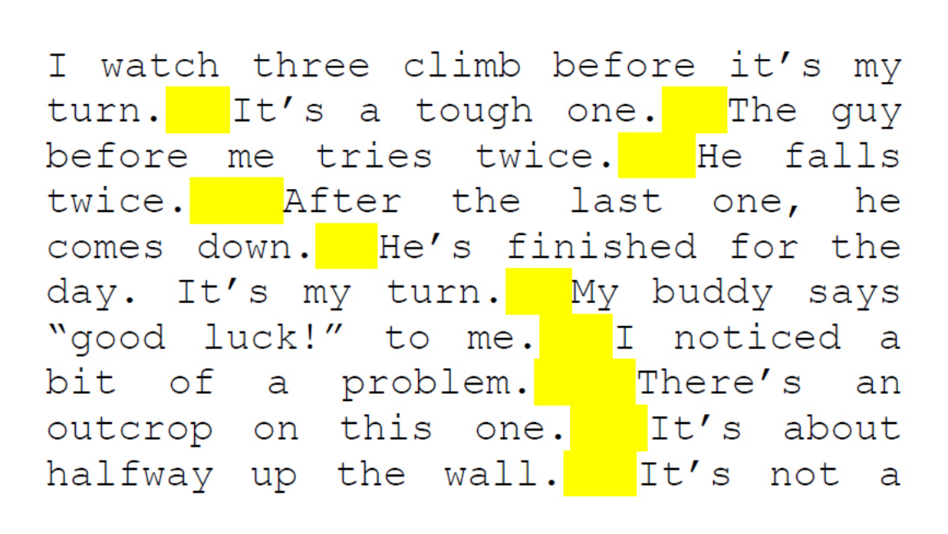
Regular Expressions
Sequence of characters that forms a search pattern
Used for finding and matching certain parts of strings
(?<=\.) {2,}(?=[A-Z])

Slide 6
Exact Matching
The simplest form of regex matching
regex
A regular expression, regex or regexp (sometimes called a rational expression) is, in theoretical computer science and formal language theory, a sequence of characters that define a search pattern.

Slide 7
Pattern Matching
Search patterns describe what should be matched
\+359[0-9]{9}
+61948228831222 – Dick
+2394818322 – Matt
+3598418 2838 – Steven
+359882021853 – Andy
+3598969233125321 – Nash

Slide 8
Using Regex in Java
Java library supports regular expressions
Pattern pattern = Pattern.compile("a");
Matcher matcher = pattern.matcher("aaaab");
while (matcher.find()) {
System.out.println(matcher.group());
}
Searches for the next match
Gets the matched text

Slide 9
Problem: Match Count
Find the occurrence count of a word in a given text
regex
Matches: 2
A regular expression, regex or regexp (sometimes called a rational expression) is, in theoretical computer science and formal language theory, a sequence of characters that define a search pattern.
Check your solution here: https://judge.softuni.bg/Contests/Practice/Index/458#0

Slide 10
Solution: Match Count
Pattern pattern = Pattern.compile(reader.readLine());
Matcher matcher = pattern.matcher(reader.readLine());
int count = 0;
while (matcher.find())
count++;
System.out.println("Matches: " + count);
Check your solution here: https://judge.softuni.bg/Contests/Practice/Index/458#0

Slide 11
Character Classes
compact dis[ck]
Match One of Several Characters

Slide 12

Character Classes
[aeiouy] – matches a lowercase vowel
[0123456789] - Мatches any digit frm 0 to 9
[0-9] - Character range. Same as above.
Four matches
Abraham Lincoln
In 1519 Leonardo da Vinci died at the age of 67.
Six matches

Slide 13
Character Classes (2)
[a-z] – Characters can also be used in a range
. - Мatches any symbol
Abraham Lincoln
Abraham Lincoln

Slide 14
Problem: Vowel Count
Find the count of all vowels in a given text
vowels are upper and lower a, e, i, o, u and y
Vowels: 5
Abraham Lincoln
In 1519 Leonardo da Vinci died at the age of 67.
Vowels: 15
Check your solution here: https://judge.softuni.bg/Contests/Practice/Index/458#0

Slide 15
Solution: Match Count
String text = reader.readLine();
Pattern pattern = Pattern.compile("[AEIOUYaeiouy]");
Matcher matcher = pattern.matcher(text);
int count = 0;
while (matcher.find())
count++;
System.out.println("Vowels: " + count);
Check your solution here: https://judge.softuni.bg/Contests/Practice/Index/458#0

Slide 16
Negation Character Classes
[^aeiouy] – matches anything except a lowercase vowel
[^0123456789] - Мatches anyting except a digit frm 0 to 9
[^0-9] - Negating a character range
Abraham Lincoln
In 1519 Leonardo da Vinci died at the age of 67.

Slide 17
Problem: Non-Digit Count
Find the count of all non-digit characters in a given text
Non-digits: 15
Abraham Lincoln
In 1519 Leonardo da Vinci died at the age of 67.
Non-digits: 42
Space is a non-digit
Check your solution here: https://judge.softuni.bg/Contests/Practice/Index/458#0

Slide 18
Solution: Non-Digit Count
String text = reader.readLine();
Pattern pattern = Pattern.compile("[^0123456789]");
Matcher matcher = pattern.matcher(text);
int count = 0;
while (matcher.find())
count++;
System.out.println("Non-digit: " + count);
Check your solution here: https://judge.softuni.bg/Contests/Practice/Index/458#0

Slide 19
Shorthand Character Classes
\d – Shorthand for [0-9]
\w – Shorthand for [a-zA-Z0-9_]
\s – Matches any white-space character (space, tab, line break)
The is year 2033.
The is year 2033.
The is year 2033.
Notes:
\w – Matches any word character (a-z, A-Z, 0-9, _)
\W – Matches any non-word character (the opposite of \w)
\s – Matches any white-space character
\S – Matches any non-white-space character (opposite of \s)
\d – Matches any decimal digit
\D – Matches any non-digit character (opposite of \d)

Slide 20
Negated Shorthand Character Classes
\D – Shorthand for [^0-9]
\W – Shorthand for [^a-zA-Z0-9_]
\S – Matches any non white-space character
The is year 2033.
The is year 2033.
The is year 2033.
Notes:
\w – Matches any word character (a-z, A-Z, 0-9, _)
\W – Matches any non-word character (the opposite of \w)
\s – Matches any white-space character
\S – Matches any non-white-space character (opposite of \s)
\d – Matches any decimal digit
\D – Matches any non-digit character (opposite of \d)

Slide 21

Quantifiers
Repetition operators

Slide 22

Quantifiers
+ - Matches the previous element one or more times
* - Matches the previous element zero or more times
\+[0-9]+
+359885976002
+
No match
\+[0-9]*
+359885976002
+
Both match

Slide 23
Quantifiers (2)
? - Matches the previous element zero or one time
{min length, max length} - Exact quantifiers
\+[0-9]?
+359885976002
+
Both match
\+[0-9]{10,12}
+359885976002
+0885976002

Slide 24
Problem: Extract Integer Numbers
Extract all integer numbers from a given text
Ignore signs or decimal separators
In 1519 Leonardo da Vinci died at the age of 67.
1519
67
Check your solution here: https://judge.softuni.bg/Contests/Practice/Index/458#0

Slide 25
Solution: Extract Integer Numbers
String text = reader.readLine();
Pattern pattern = Pattern.compile("\\d+");
Matcher matcher = pattern.matcher(text);
while (matcher.find()) {
System.out.println(matcher.group());
}
Check your solution here: https://judge.softuni.bg/Contests/Practice/Index/458#0

Slide 26
Lazy Quantifiers
Quantifiers are greedy by default
Make a quantifier lazy with ?
Greedy repetition
"\.+"
Text "with" some "quotations".
Lazy repetition
"\.+?"
Text "with" some "quotations".

Slide 27
Problem: Extract Tags
Extract all tags from a given HTML
Read until an END command
<!DOCTYPE html>
<html lang="en">
<head>
<meta charset="UTF-8">
<title>Title</title>
</head>
</html>
END
<!DOCTYPE html>
<html lang="en">
<head>
<meta charset="UTF-8">
<title>
</title>
</head>
</html>
Check your solution here: https://judge.softuni.bg/Contests/Practice/Index/458#0

Slide 28
Solution: Extract Tags
Pattern pattern = Pattern.compile("<.*?>");
String text = reader.readLine();
while (!text.equals("END")) {
Matcher matcher = pattern.matcher(text);
while (matcher.find())
System.out.println(matcher.group());
text = reader.readLine();
}
Dot matches any character
Check your solution here: https://judge.softuni.bg/Contests/Practice/Index/458#0

Slide 29



Basic Regex
Exercises in class

Slide 30
Special Characters
[\^$.|?*+()
Reserved for Special Use

Slide 31
Special Characters
. - Dot matches any character
| - Pipe is a logical OR
\+.+
+359 885/97-60-02
\+359( |-).+
No match
+359 885/97-60-02
+359-885/97-60-02
+359/885/97-60-02

Slide 32

Special Characters (2)
[() - Brackets
+*? - Quantifiers
^$ - Anchors
\/ - Slashes
\+([0-9/- ]+)
+359 885/97-60-02
Escape special characters with backslash

Slide 33

Anchors
^ - The match must start at the beginning of the string or line
$ - The match must occur at the end of the string or before \n
^\w{6,12}$
short
too_long_username
!lleg@l_ch@rs
jeff_butt
johnny

Slide 34
Problem: Valid Usernames
Scan through the lines for valid usernames:
Has length between 3 and 16 characters
Contains letters, numbers, hyphens and underscores
Has no redundant symbols before, after or in between
sh
too_long_username
!lleg@l ch@rs
jeff_butt
END
invalid
invalid
invalid
valid
Check your solution here: https://judge.softuni.bg/Contests/Practice/Index/458#0

Slide 35
Solution: Valid Username
Pattern pattern =
Pattern.compile("^[a-zA-Z0-9_-]{3,16}$");
String text = reader.readLine();
while (!text.equals("END")) {
Matcher matcher = pattern.matcher(text);
if (matcher.find())
System.out.println("valid");
else
System.out.println("invalid");
text = reader.readLine();
}
Check your solution here: https://judge.softuni.bg/Contests/Practice/Index/458#0

Slide 36

Constructs
Grouping and Backreference

Slide 37
Grouping Constructs
(subexpression) - Captures a numbered group
(?<name>subexpression) - Captures a named group
Group 0 = 22-Jan-2015
Group 1 = 22 Group 2 = Jan Group 3 = 2015
(\d{2})-(\w{3})-(\d{4})
22-Jan-2015
\d{2}-(?<month>\w{3})-\d{4}
Group 0 = 22-Jan-2015
Group "month" = Jan
22-Jan-2015

Slide 38

Problem: Valid Time
Scan through the lines for valid times
Valid time:
is in the interval 12:00:00 AM to 11:59:59 PM
has no redundant symbols before, after or in between
12:33:24 AM
33:12:11 PM
inv 23:52:34 AM
00:13:23 PM
END
valid
invalid
invalid
invalid
Check your solution here: https://judge.softuni.bg/Contests/Practice/Index/458#0

Slide 39
Solution: Valid Time
BufferedReader reader = new BufferedReader( new InputStreamReader(System.in));
Pattern pattern = Pattern.compile( "^(\\d{2}):(\\d{2}):(\\d{2}) [AP]M$");
String text = reader.readLine();
// continues...
Check your solution here: https://judge.softuni.bg/Contests/Practice/Index/458#0

Slide 40
Solution: Valid Time
while (!text.equals("END")) {
Matcher matcher = pattern.matcher(text);
if (matcher.find())
if (isValidTime(matcher))
System.out.println("valid");
else
System.out.println("invalid");
else
System.out.println("invalid");
text = reader.readLine();
}
Check if:
1 <= hh <= 12
0 <= mm <= 59
0 <= ss <= 59
Check your solution here: https://judge.softuni.bg/Contests/Practice/Index/458#0

Slide 41
Grouping Constructs (2)
(?:subexpression) – Defines a non-capturing group
^(?:Hi|hello),\s*(\w+)$
Hi, Peter
Group 0 = Hi, Peter
Group 1 = Peter
Ungrouped = Hi
Notes:
Non capturing groups are necessary when you want to exclude alternations captured as a group.

Slide 42
Backreference Constructs
\number – matches the value of a numbered group
\k<name> – matches the value of a named group
\d{2}(-|\/)\d{2}\1\d{4}
Group 0 = Whole Match
Group 1 = - or /
22-12-2015
05/08/2016
\d{2}(?<del>-|\/)\d{2}\k<del>\d{4}
22-12-2015
05/08/2016
Group 0 = Whole Match
Group 1 = - or /

Slide 43
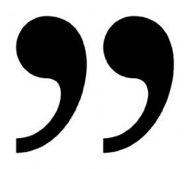
Problem: Extract Quotations
Extract all quotations from a text
Valid quotation starts and ends with:
Single quotes
Double quotes
Similar kind of quotes
<a href='/' id="home">Home</a><a class="selected"</a><a href = '/forum'>
/
home
selected
/forum
Check your solution here: https://judge.softuni.bg/Contests/Practice/Index/458#0

Slide 44
Solution: Extract Quotations
String text = reader.readLine();
Pattern pattern = Pattern.compile("(\"|')(.*?)\\1");
Matcher matcher = pattern.matcher(text);
while (matcher.find()) {
System.out.println(matcher.group(2));
}
Check your solution here: https://judge.softuni.bg/Contests/Practice/Index/458#0

Slide 45
Regex Constructs
Exercises in class

Slide 46
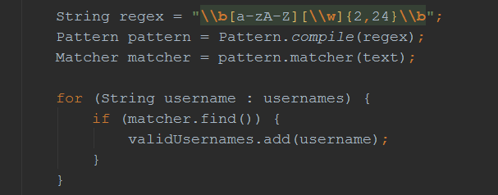
Regex in Java
Using Built-In Regex Classes

Slide 47
Regex in Java
Regex in Java library
java.util.regex.Pattern
java.util.regex.Matcher
Pattern pattern = Pattern.compile("a*b");
Matcher matcher = pattern.matcher("aaaab");
boolean match = matcher.find();
String matchText = matcher.group();

Slide 48
Validating String By Pattern
Pattern.matches(String pattern, String text) – determines whether the text matches the pattern
String text = "Today is 2015-05-11";
String pat = "\\d{4}-\\d{2}-\\d{2}";
boolean containsValidDate =
Pattern.matches(pat, text);
System.out.print(containsValidDate); // true

Slide 49
Checking for a Single Match
find() - Gets the first pattern match
String text = "Andy: 123";
String pattern = "([A-Z][a-z]+): (\\d+)";
Pattern regex = Pattern.compile(pattern);
Matcher matcher = regex.matcher(text);
matcher.find();
Group 0 = Andy: 123
Group 1 = Andy Group 2 = 123

Slide 50
Replacing With Regex
replaceAll(String replacement) – replaces all matches
String text = "Andy: 123, Branson: 456";
String pattern = "\\d{3}";
String replacement = "999";
Pattern regex = Pattern.compile(pattern);
Matcher matcher = regex.matcher(text);
String result = matcher.replaceAll(replacement);
"Andy: 999, Branson: 999"

Slide 51
Splitting With Regex
split(String pattern) – splits the text by the pattern
Returns String[]
String text = "1 2 3 4";
String pattern = "\\s+";
String[] tokens = text.split(pattern);
tokens = { "1", "2", "3", "4" }

Slide 52
Helpful Resources
https://regex101.com and http://regexr.com – websites to test Regex using different programming languages
http://docs.oracle.com/javase/7/docs/api/java/util/regex/Matcher – a quick reference for Regex from Oracle
http://regexone.com – interactive tutorials for Regex
http://www.regular-expressions.info/tutorial.html – a comprehensive tutorial on regular expressions

Slide 53

Summary
Regular expressions describe patterns for
searching through text
Define special characters, operators and
constructs
Powerful tool for extracting or validating data
Java provides a built-in Regex classes

Slide 54









Regular Expressions
https://softuni.bg/courses/programming-fundamentals

Slide 55

License
This course (slides, examples, demos, videos, homework, etc.) is licensed under the "Creative Commons Attribution-NonCommercial-ShareAlike 4.0 International" license
Attribution: this work may contain portions from
"Fundamentals of Computer Programming with Java" book by Svetlin Nakov & Co. under CC-BY-SA license
"C# Part I" course by Telerik Academy under CC-BY-NC-SA license
"C# Part II" course by Telerik Academy under CC-BY-NC-SA license

Slide 56





Free Trainings @ Software University
Software University Foundation – softuni.org
Software University – High-Quality Education, Profession and Job for Software Developers
softuni.bg
Software University @ Facebook
facebook.com/SoftwareUniversity
Software University @ YouTube
youtube.com/SoftwareUniversity
Software University Forums – forum.softuni.bg

